Slide 1

The Procedure of Dicom Files
By：Wu Yuan, Zhao Pu
Date： 2019/3/1

Slide 2
Dicom : Digital Imaging and Communications in Medicine
Dicom Viewer: RadiAnt, MicroDicom

Slide 3
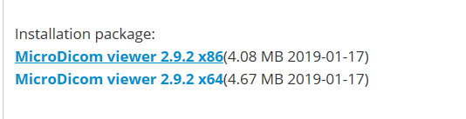
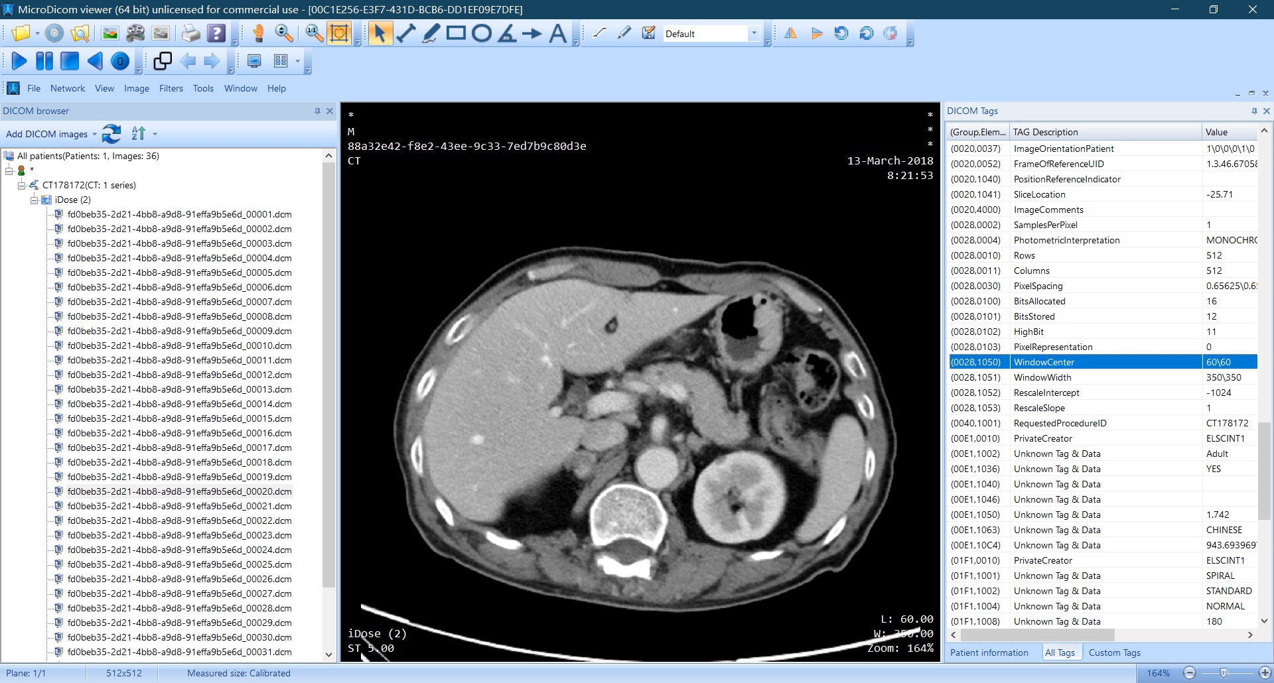
MicroDicom :
http://www.microdicom.com/downloads.html

Slide 5
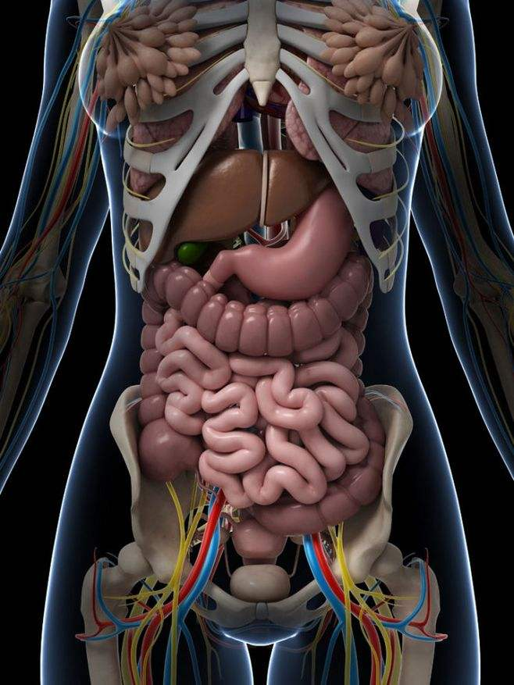
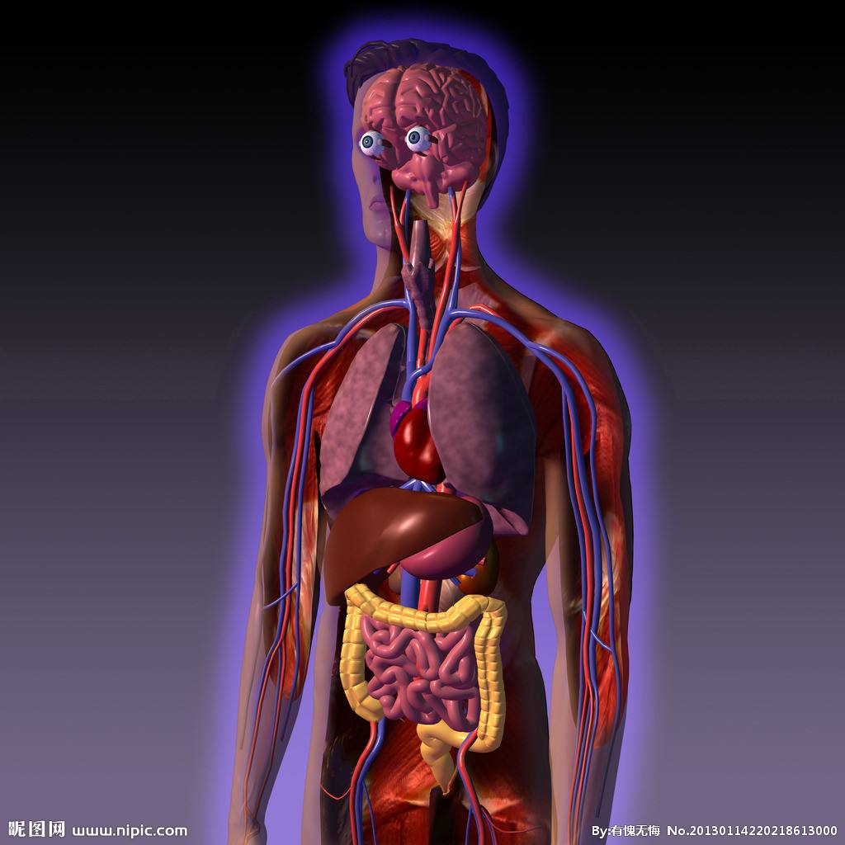

Slide 6
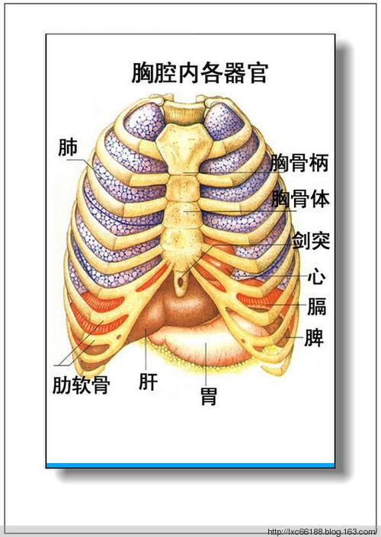
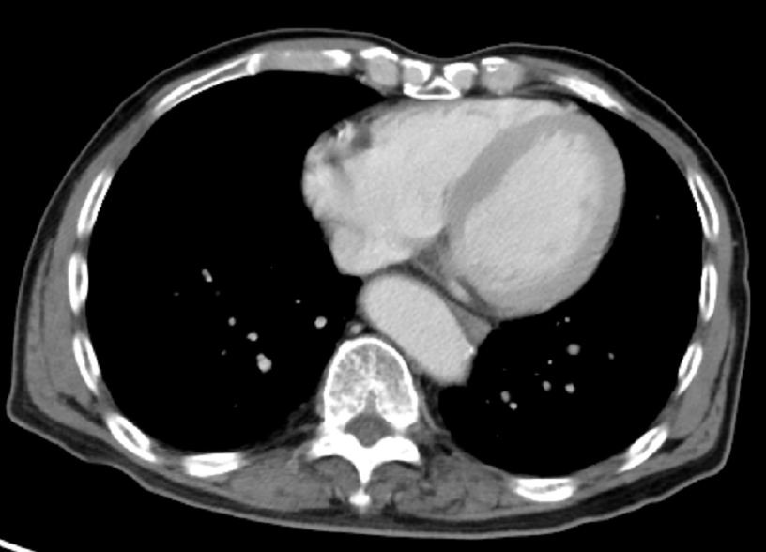
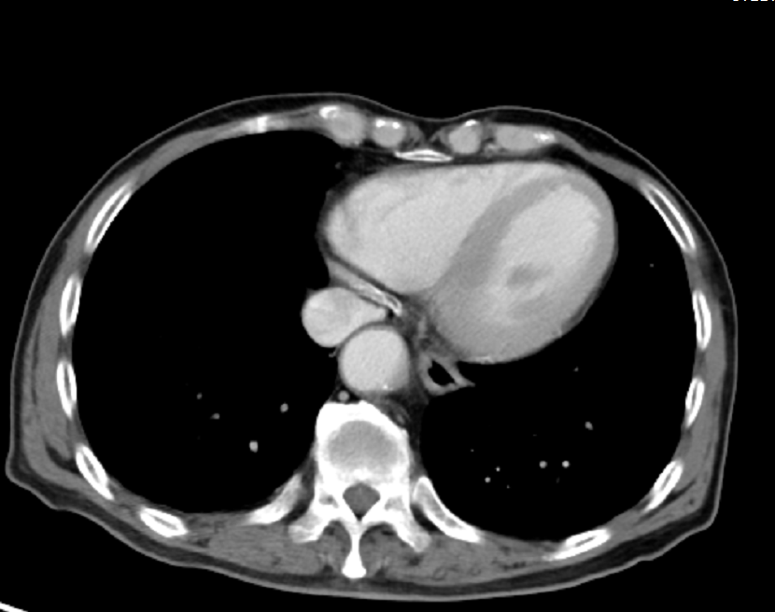
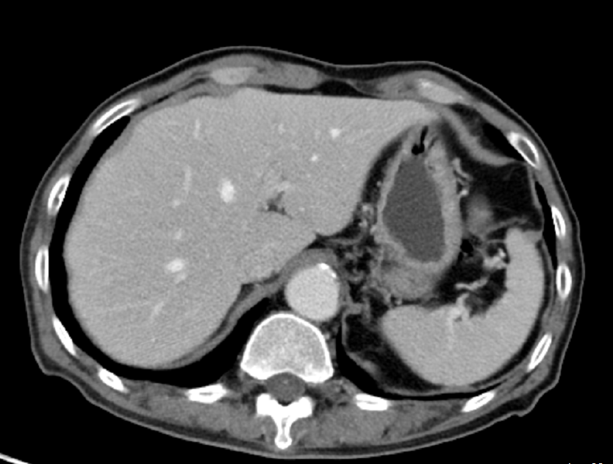
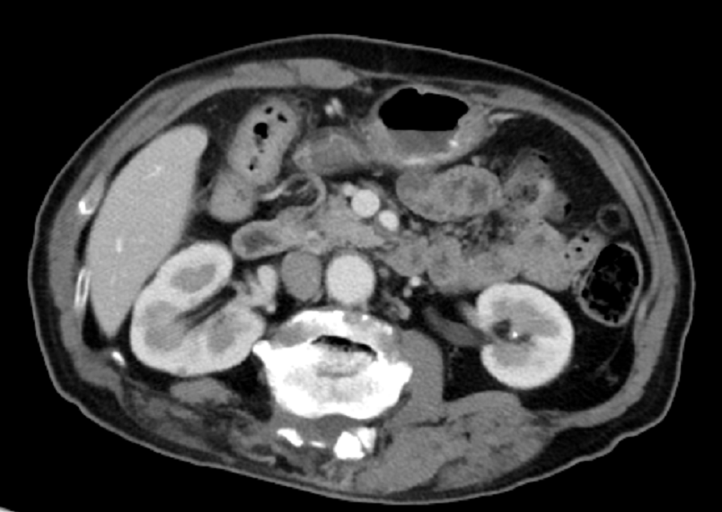
1
2
3
4

Slide 7
Main procedure
PyDicom
Reading
1
Numpy
Transform
2
WindowWidth
WindowCenter
3
Pixel Processing
4
Picture showing and saving
5

Slide 8
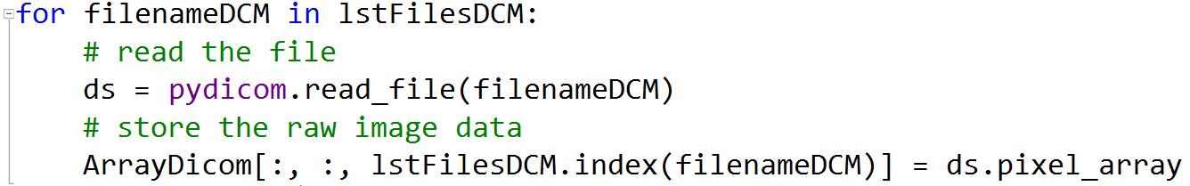
PyDicom Reading and Numpy Transform
ConstPixelDims 512*512*len(filenamelist)
dtype = uint16
pydicom.read_file(filename)
dicomfile.pixel_array

Slide 9
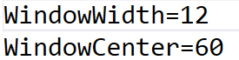
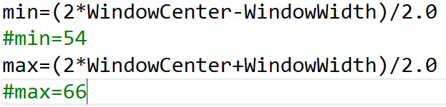
Window Center and Winder Width
1 Read from the dicom files
2 Give directly
3 Calculate min and max

Slide 10
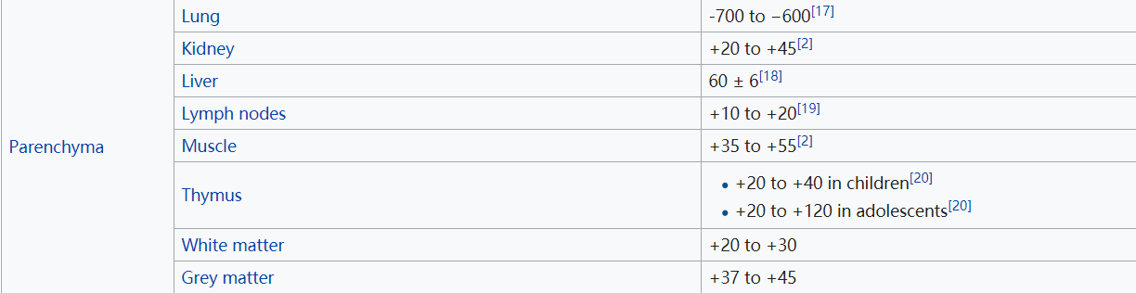
Window Center and Winder Width
https://en.wikipedia.org/wiki/Hounsfield_scale

Slide 11
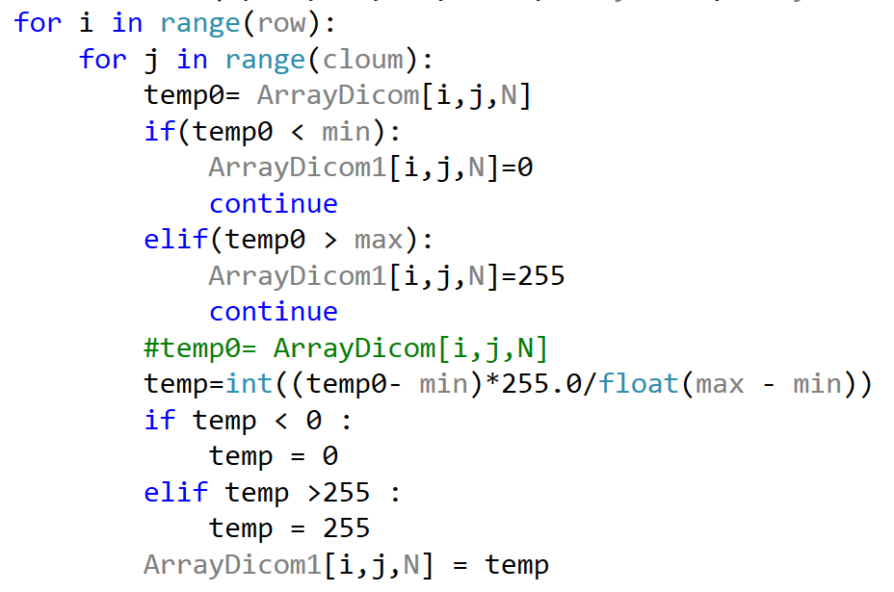
Pixel Processing

Slide 12
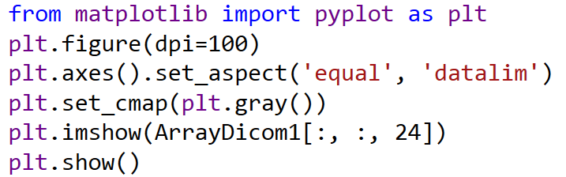
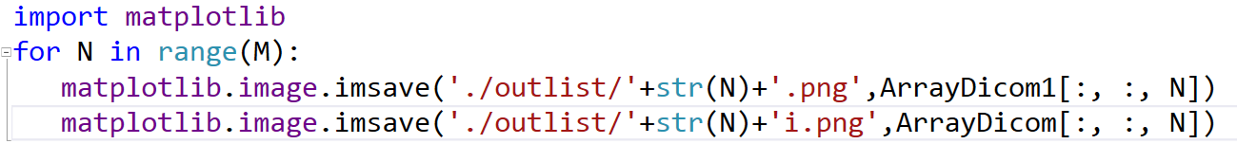
Picture showing and saving

Slide 13
Problems and analyzing
Using:
train_dataset/00C1E256-E3F7-431D-BCB6-DD1EF09E7DFE/
00001 00004 00021

Slide 14
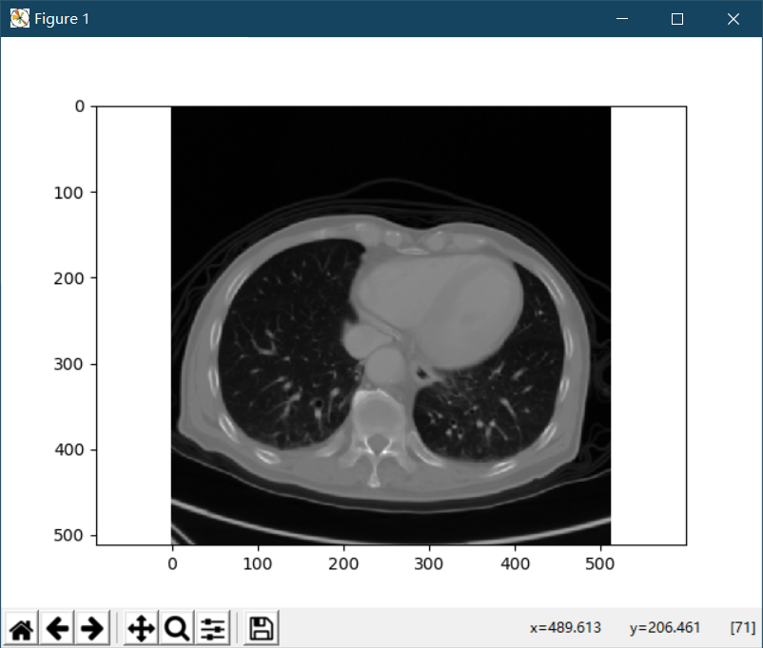
Problems: Pic1

Slide 15
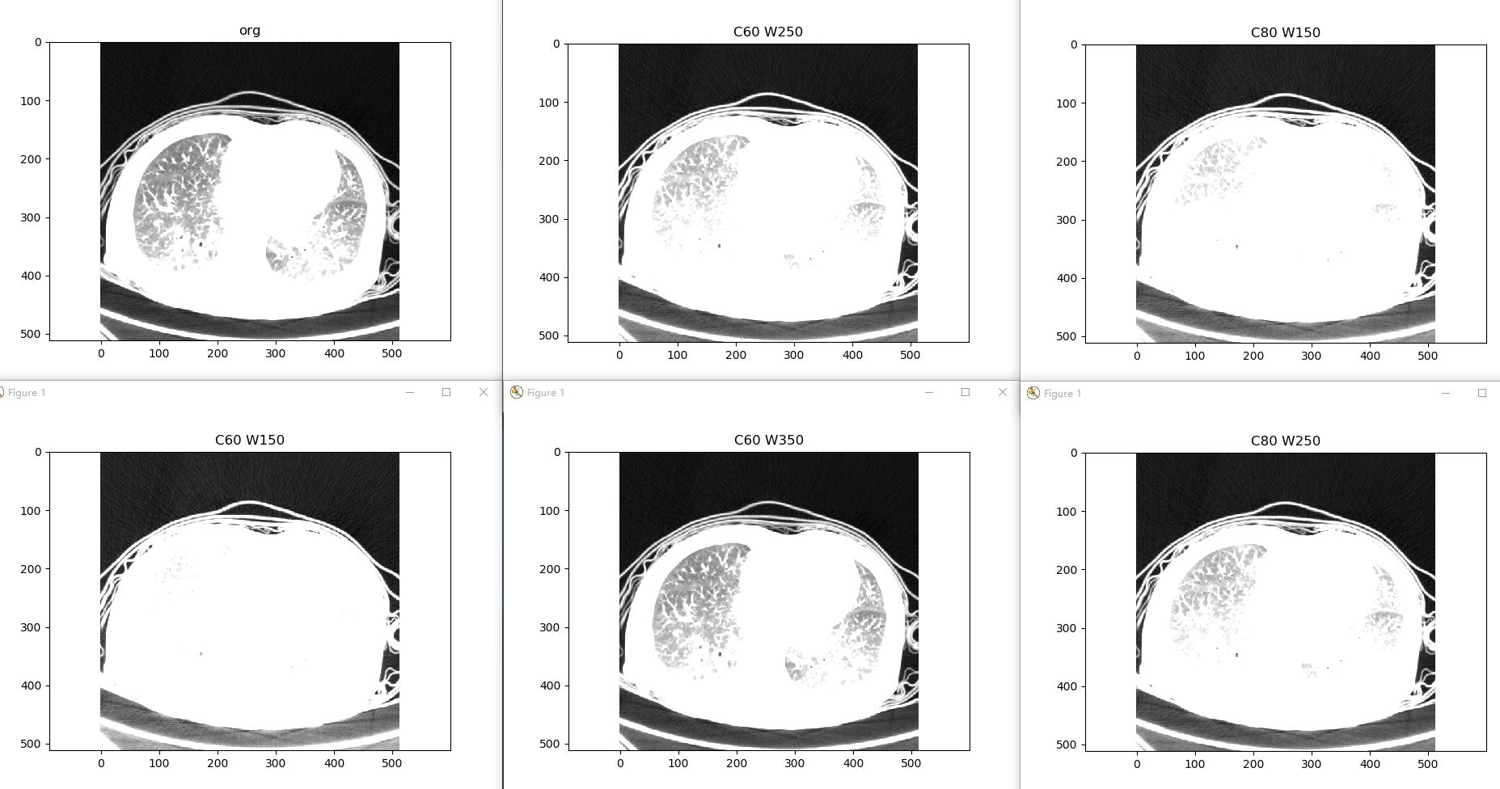
Problems: Pic1

Slide 16
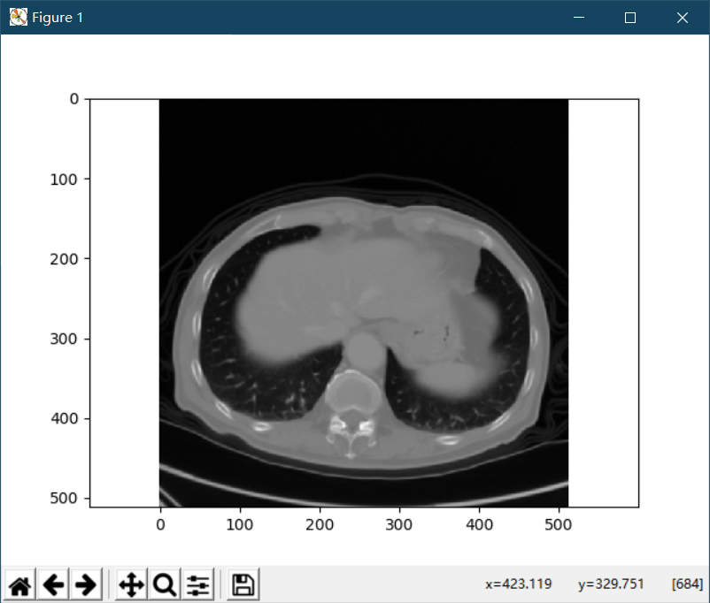
Problems: Pic4

Slide 17
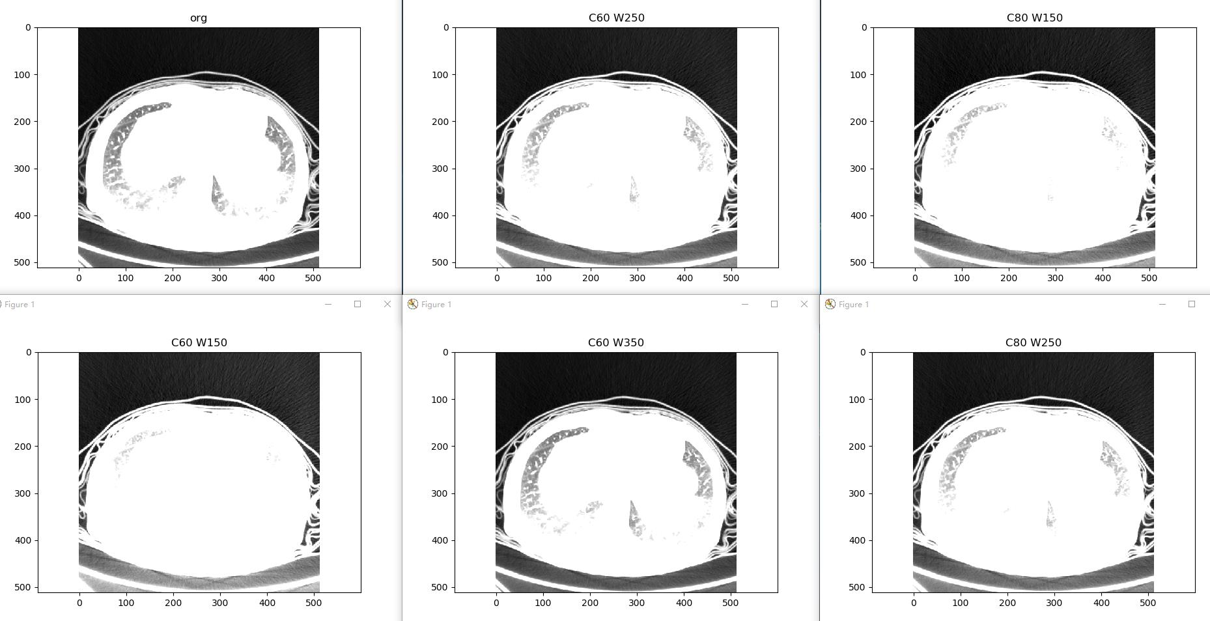
Problems: Pic4

Slide 18
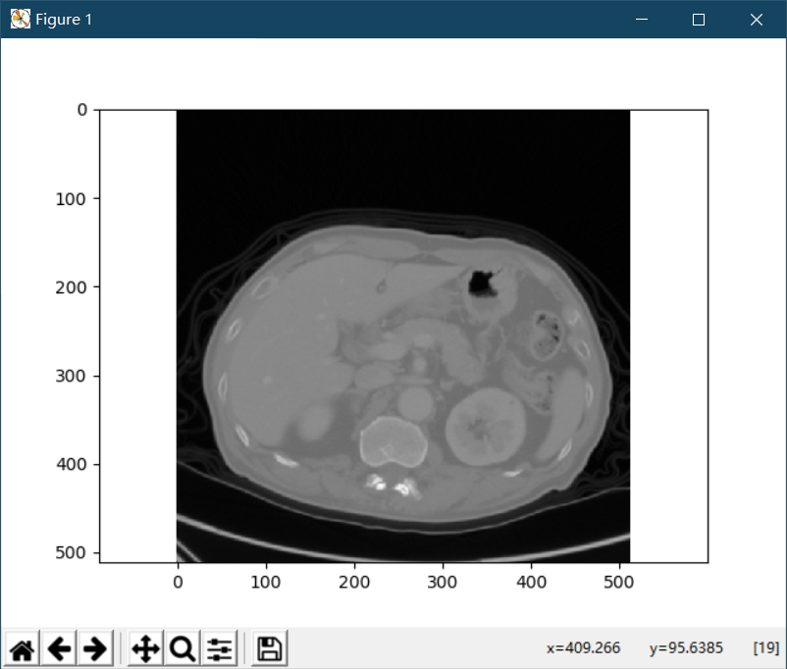
Problems: Pic21

Slide 19
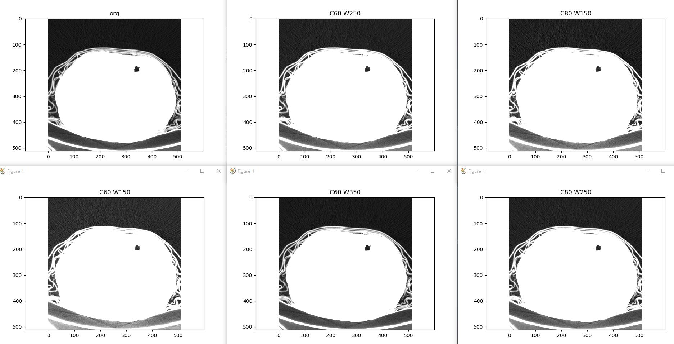
Problems: Pic21

Slide 20
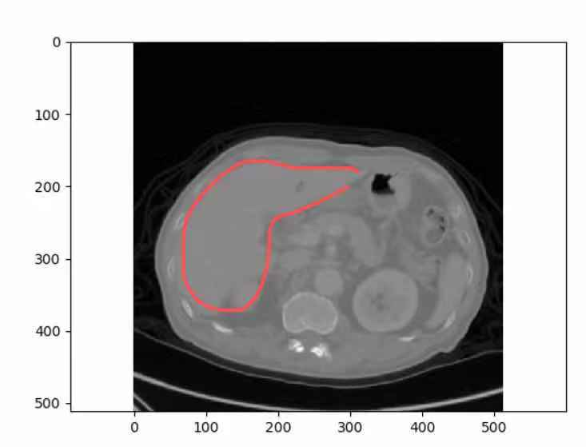
Problems and analyzing
1.Should choose several pics which contain the liver
2.Should transform the pixels form uint16 to 0~255 by correct window center and window width, which may be still a tuff problem.
3.Using the 60+6(Hu) then the picture could show nothing because the initial dates are not in the target range.

Slide 21
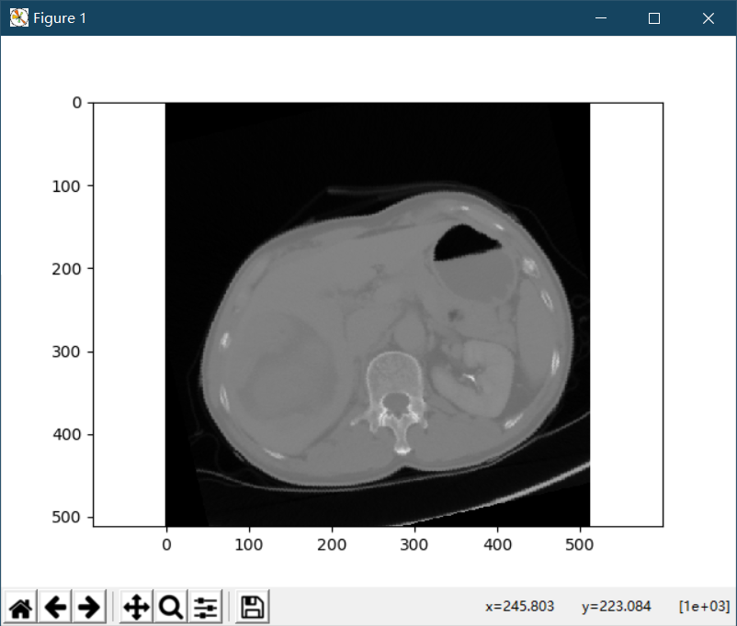
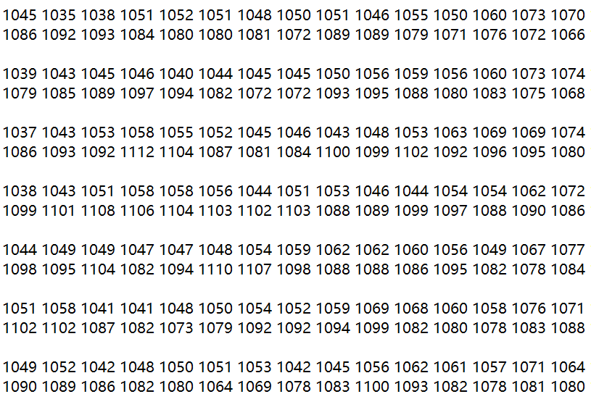
Problems and analyzing
Choose (250~300,150~200)

Slide 22
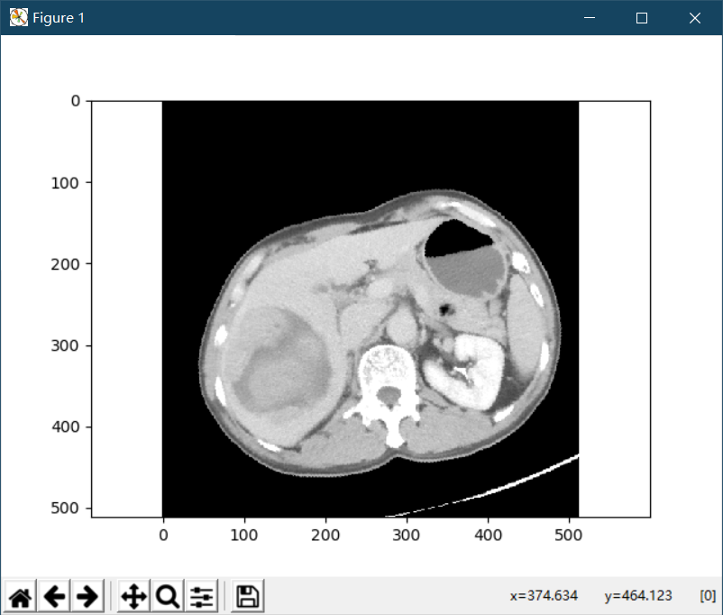
Problems and analyzing
WindowCenter 1000 WindowWidth 350
So the value of window center and window width is still a problem.

Slide 23
Questions：
1. Picture effect
2. The value of Center and Width

Slide 24
Thank You

